Slide 1

Class Two – From Writer to Author
Session 1 – Editing Your Book – Part 1
Allen H. Mesch
For
Plano Parks and Recreation

Slide 2
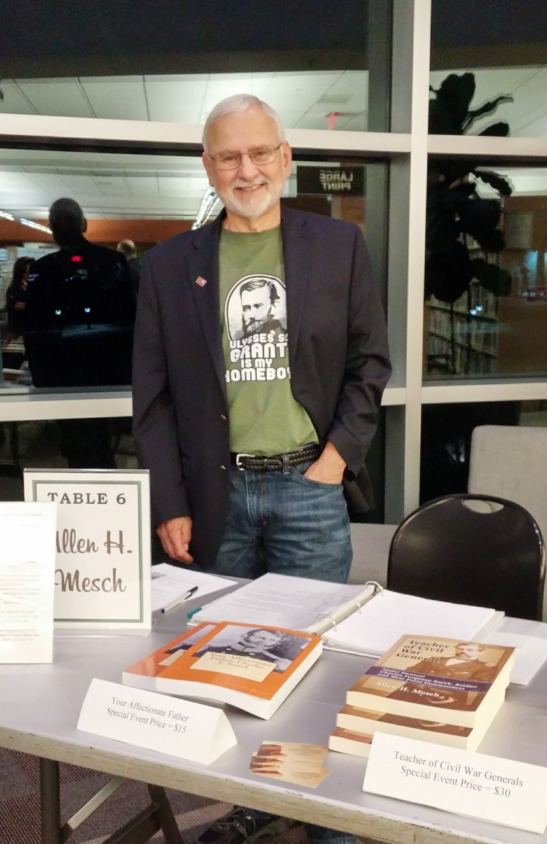
Introductions
Who am I?
Born in Buffalo, NY
Studied Chemical Engineering
Worked in the oil and gas industry
Taught at local colleges
Wrote eight books
Who are you?
Introduction
How many words have you written?
What problems have you encountered?

Slide 3
Class Two – From Writer to Author
In Class Two, you will learn how to edit your book, the merits of blogs to promote you and your book, how to find the “right” people to review your book, and the pros and cons of writing groups.
Session 1 – Editing Your Book
  Homework – Review Your First Draft
Session 2 – Editing Services and Writing Clubs
  Homework – Attending Writing Group
Session 3 – Other Parts of Your Book
  Homework – Write Brief Description of Book
Session 4 – Pre-publication Promotion
  Homework – Prepare Facebook Author Page

Slide 4
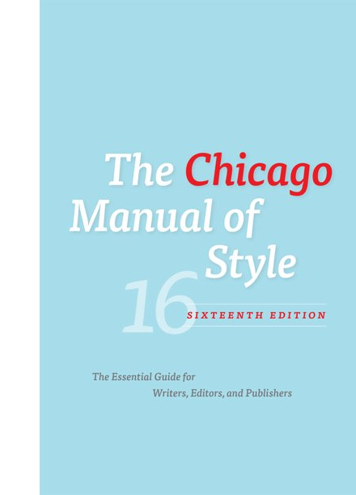
The Chicago Manual of Style
Part I · The Publishing Process
Books and Journals
Manuscript Preparation, Manuscript Editing, and Proofreading
Illustrations and Tables
Rights, Permissions, and Copyright Administration
Part II · Style and Usage
Grammar and Usage
Punctuation
Spelling, Distinctive Treatment of Words, and Compounds
Names, Terms, and Titles of Works
Numbers & Abbreviations
Languages Other than English
Mathematics in Type
Quotations and Dialogue
Part III · Source Citations and Indexes
Notes and Bibliography
Author-Date References
The Chicago Manual of Style, 17th ed. Chicago: University of Chicago Press, 2017. https://doi.org/10.7208/cmos17
c Allen H. Mesch

Slide 5

Understand the Editing Process
Writing a first draft is an act of pure creation.
Editing is an analytical, problem-solving process
Pointers to get in that editing frame of mind:
Set your manuscript aside for a few days before you begin editing.
Read it with new eyes.
Don’t try to fix everything at the same time.
Don’t worry about making each sentence perfect.
Remove parts that don’t serve the bigger picture.

Slide 6

Fixing ‘Big Picture’ Problems - Plot
Plot consists of a story's connected events, with each leading to another plot point.
Plot must connect in a logical order that escalates to a climax.
It should deliver on what the setup of the story promises.
Plot questions checklist:
Is the plot engaging and believable?
Do plot points flow logically and gather or maintain momentum?
Are all major and minor narrative threads tied up by the ending?
Do the plot twists make sense?
Are there holes in the story?
Does the plot match the conventions of your genre?
Write a one sentence summary of each scene on individual flashcards and pin them onto a corkboard.

Slide 7
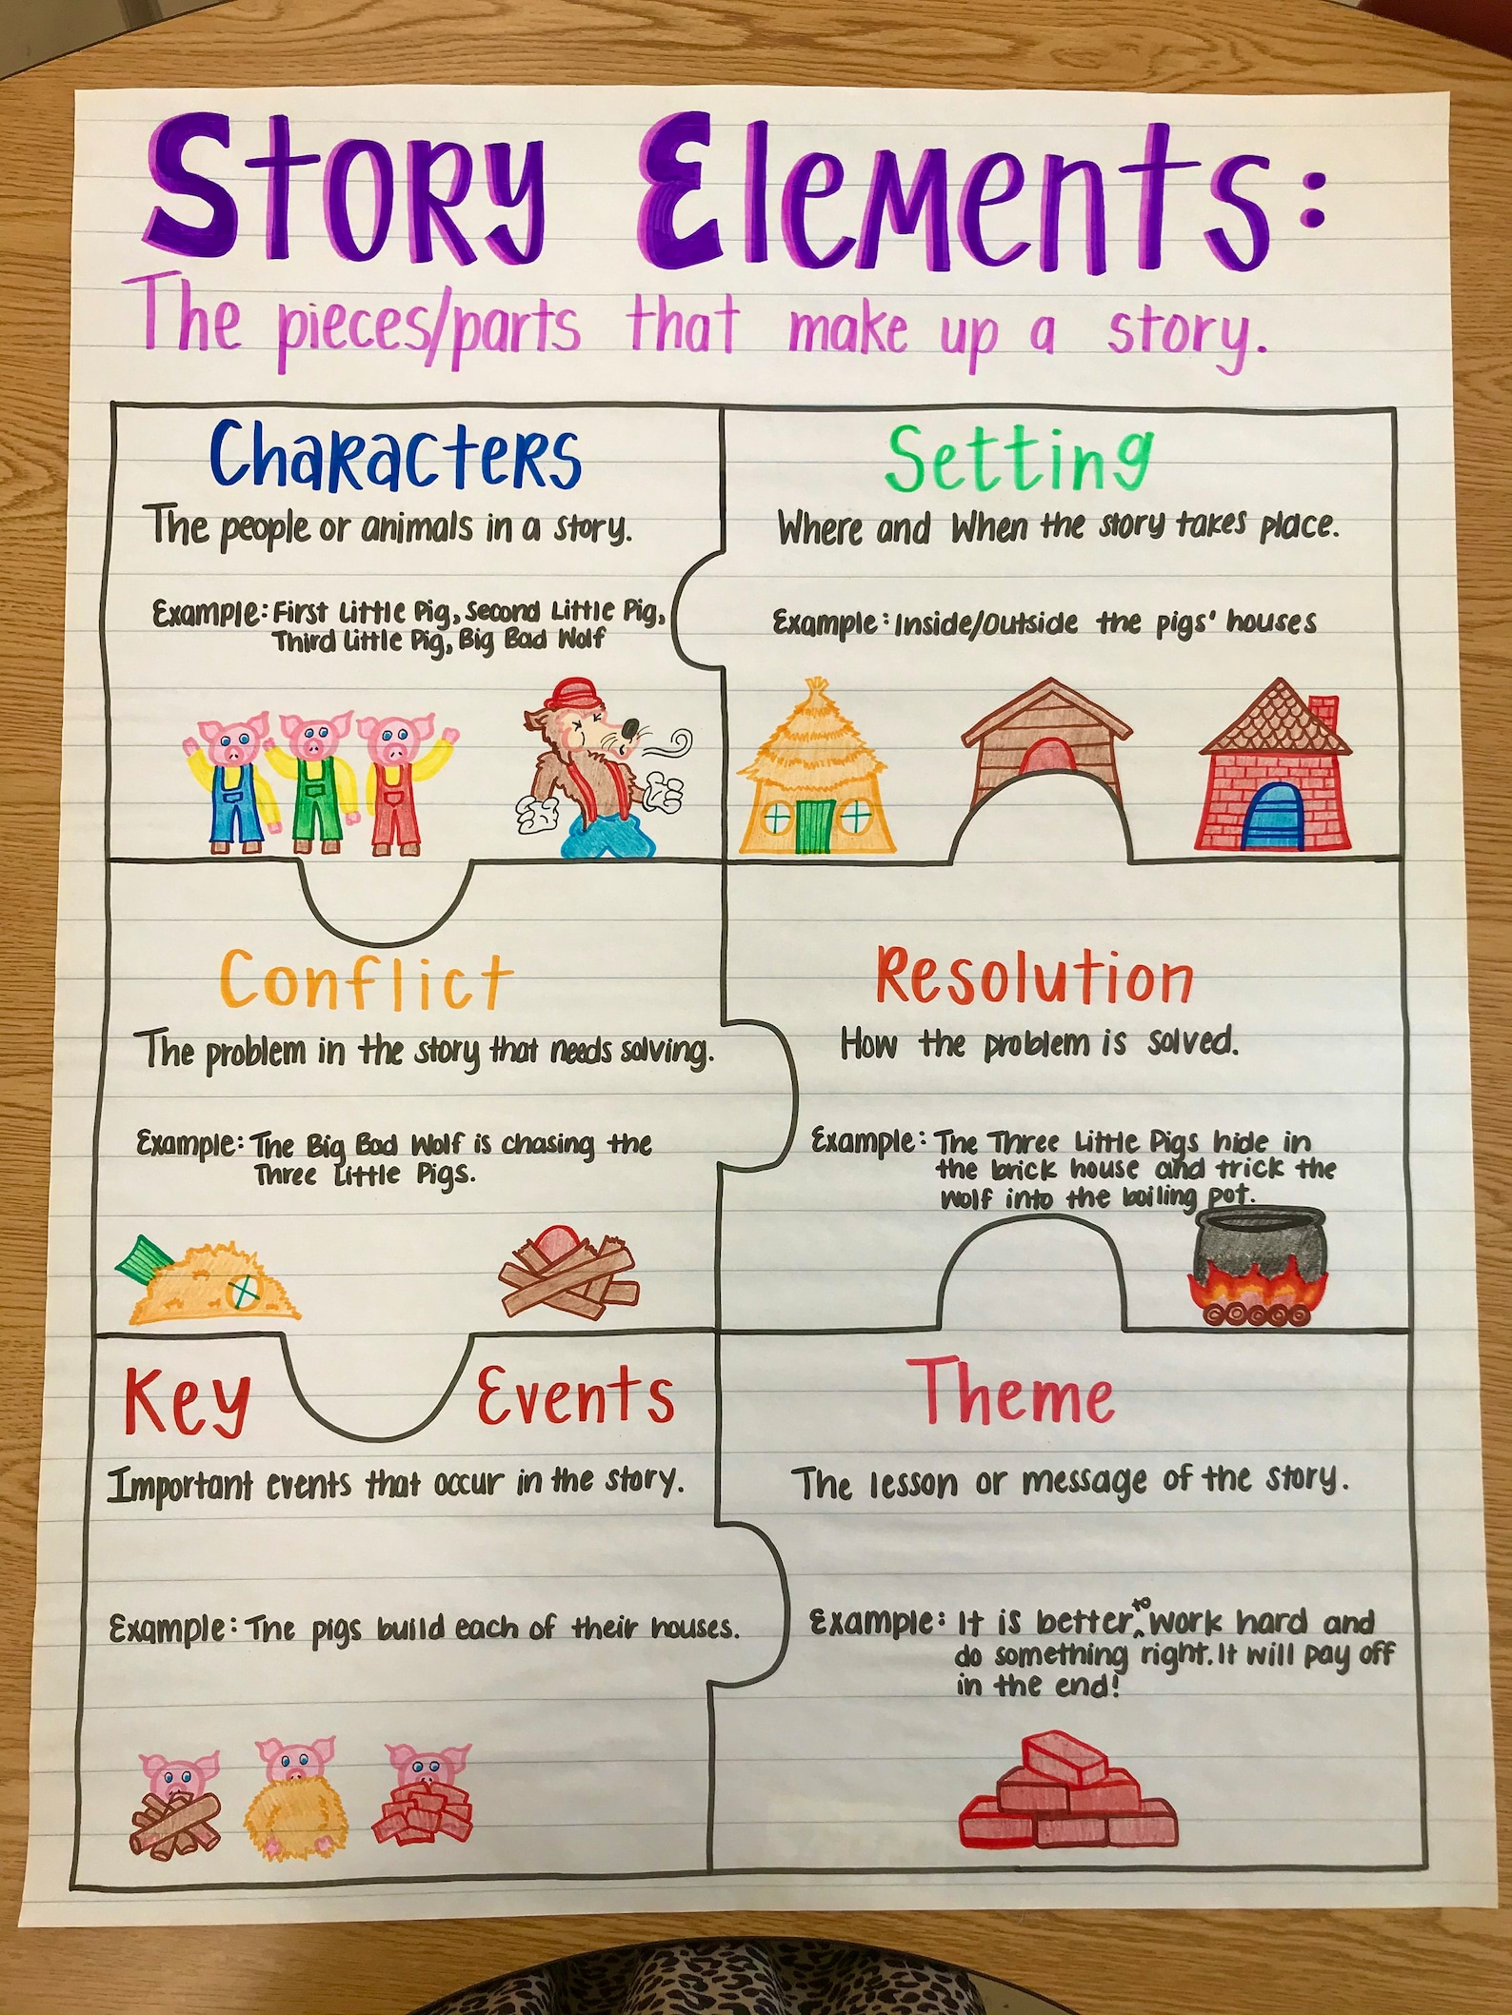
Fixing ‘Big Picture’ Problems – Story Structure
While a book’s plot can go anywhere, story structure isn’t as flexible.
Stories largely follow the same pattern:
A hero is in a ‘normal world’ before something forces them out of their comfort zone, and in pursuit of a goal that they must either achieve or face the consequences.
Distill your story into a single sentence following this formula:
[Character] must [do something] to achieve [goal] or else [reason why the audience should care]?

Slide 8
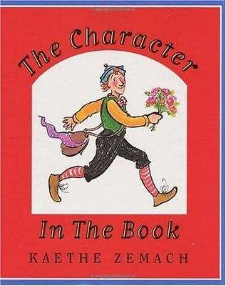
Fixing ‘Big Picture’ Problems - Character
A story is about how a character reacts to an event or situation.
For your protagonist to go on a satisfying, challenging journey
certain things need to be in place: 1. a primary goal, 2. strengths that can help them reach it, and 3. weaknesses that get in the way.
Antagonists and secondary characters should also have a rich, relatable inner life, they need to contribute to the protagonist’s story.
They should somehow help, hinder, or shed light on your main character.

Slide 9
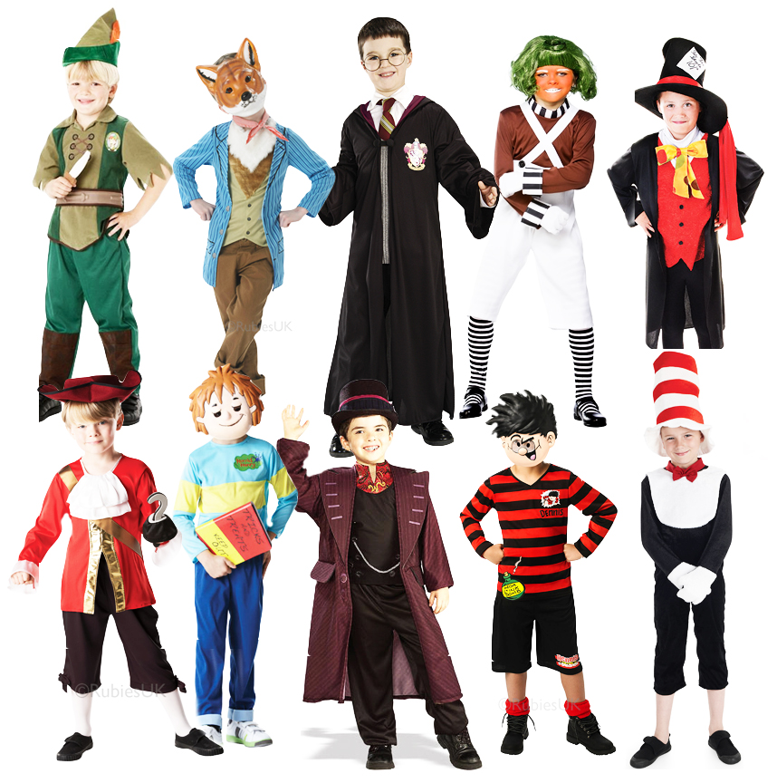
Fixing ‘Big Picture’ Problems – Character – Part 2
  Are your characters sufficiently rounded to carry a story?
  Do the main characters have clear traits, strengths, and weaknesses?
  What are the protagonist and antagonist's motivations?
  Do characters act believably and consistently in each scene?
  How do the secondary characters serve the story?
  Chart each main character's overall arc. Is every arc clear and compelling?

Slide 10
Editing Checklist for Conflict and Themes – Part 1
Conflict is at the heart of every story
  Conflict must escalate over the course of the story.
  The roadblocks preventing your protagonist from achieving their goal must become more insurmountable as the story goes on.
  This builds tension, assure your readers that your story is going somewhere, grow your stakes, and allow your big finish to have an even greater impact.
Fleshing out your themes
  A theme is a story's central idea.
  It is a concept that underpins its narrative.
  Theme can either be a definitive message like, “greed is the greatest force in human culture,” or abstract ideas like love, loss, or betrayal.

Slide 11
Editing Checklist for Conflict and Themes – Part 2
Editing checklist for conflict and themes:
Are your intended themes developed through conflict?
Is the central conflict intriguing and clear?
Is it resolved when the story ends?
Does this conflict escalate gradually over the course of the book?
What dramatic question(s) arise, and are they answered by the end?
What sacrifice is your protagonist faced with making at the climax?

Slide 12
Do a “Scene by Scene” Edit - Part 1 - Scenes and Chapters
Examine important scenes like the opening, the inciting incident, and the climax.
Editing checklist for scenes and chapters:
Does the opening scene hook readers? Does it begin in the right place?
Are there enough scenes, and does each one serve a purpose?
Are scenes paced well and are your chapter lengths appropriate?
Is each scene clearly defined in time and place?
Could each scene start later or be moved?
Is forewarning, if applicable, used effectively?
Are scene and chapter transitions smooth?
Make sure your pacing isn't too slow or too fast.

Slide 13
Do a “Scene by Scene” Edit - Part 2 - Dialogue
Editing checklist for dialogue:
Does the dialogue
  Serve a purpose in each scene?
  Provide information?
  Advance the plot?
  Help the pace of the story?
Does each character have a distinct voice?
Does the word choice accurately reflect the time and place?
Is there a balance among dialogue tags, action beats, and implied tags?
Have you mostly used "said," and only occasionally other words for said?

Slide 14
Do a “Scene by Scene” Edit - Part 3 - Other Words for Said
Neutral Words | Happy/Excited Words | Angry Words | Sad/Upset Words | Annoyed Words
Added Agreed Announced Asserted Began Blurted Commented Declared Elaborated Greeted Interjected Noted Persisted Remarked Replied Stated Suggested Urged | Approved Beamed Bubbled Chattered Cheered Chimed in Chuckled Congratulated Complimented Crooned Exclaimed Giggled Gushed Joked Laughed Praised Rejoiced Thanked | Accused Badgered Bellowed Cursed Demanded Exploded Fumed Growled Hissed Insulted Ranted Roared Scolded Screamed Spat Shouted Swore Yelled | Agonized Apologized Bawled Blubbered Cried Fretted Grieved Groaned Lamented Moaned Mumbled Sobbed Sighed Sniffled | Complained Criticized Grumbled Grunted Insisted Mocked Retorted Scoffed Smirked Snapped Whined
270+ Other Words for "Said" to Enhance
Your Dialogue (reedsy.com)
Notes:
270+ Other Words for "Said" to Enhance Your Dialogue (reedsy.com)

Slide 15
Do a “Scene by Scene” Edit – Part 4 – Prose and Perspective
Editing checklist for point of view and prose:
Is the narrator’s voice clear and consistent?
If the point of view character changes, how is that change marked?
Could there be a better alternative viewpoint character in any given scene?
Does the prose style more-or-less match the point of view character's voice?
Does each sentence contribute to the story?
Do you “show, don’t tell” in your dialogue, characters, and setting?

Slide 16
Eliminate Sentence Mistakes – Part 1
The copy edit is the final step
If you spot a grammatical error, you know exactly how to fix it.
Here are 10 tips for copy editing your writing:
1. Replace passive voice with active voice where appropriate.
  ❌ The ball was kicked.
  ✅ She kicked the ball.
2. Limit the use of adverbs in your dialogue tags. (Show, don’t tell!)
  ❌ “Why did you eat my turkey sandwich?” said Harry angrily.
  ✅ Harry upended the table. “Why did you eat my turkey sandwich?”
3. Replace weak verbs and adverbs with stronger verbs.
  ❌ Leonard ran quickly to school.
  ✅ Leonard sprinted to school.

Slide 17
Eliminate Sentence Mistakes – Part 2
4. Replace all “hidden” verbs.
  ❌ Offer an explanation
  ✅ Explain
5. Delete vague, subjective words and “crutch” words.
  ❌ “could,” “might,” “maybe,” “more,” “poor,” “some,” “multiple,” etc.
  ❌ “really,” “literally,” “suddenly,” “simply,” “just,” “a little,” “almost,” etc.
6. Check for instances of overly complicated language.
  ❌ In close proximity
  ✅ Near
7. Delete all instances of clichés in the text.
  ❌ It was a dark and stormy night.

Slide 18
Eliminate Sentence Mistakes – Part 2
8. Check that all your dialogue is formatted correctly.
  ❌ “I love you.” Said Pam.
  ✅ “I love you,” said Pam.
9. Make sure the point of view doesn't accidentally shift. (Head hopping)
  ❌ She was just settling down with a cup of coffee when the fire alarm went off. “Oh, perfect timing.” I grabbed my coffee and stood back up.
10. Watch out for descriptive inconsistencies.
  ❌ Devon's blonde hair shone in the sunlight ... “Whatever you say, man,” replied Devon, flipping his brown locks away from his eyes.

Slide 19
Suggested Homework
Review the First Three Chapters of Your First Draft
  Does the opening scene hook readers?
  Does your protagonist have 1. a primary goal, 2. strengths that can help them reach it, and 3. weaknesses that get in the way?
  Is the central conflict intriguing and clear?
  How many “saids” did you find?
  Do you “show, don’t tell” in your dialogue, characters, and setting?

Slide 20
Class Two – From Writer to Author
Session 2 – Editing Your Book – Part 2
Allen H. Mesch
For
Plano Parks and Recreation

Slide 21

Review
Previous Class
    Chicago Manual of Style
    Fixing ‘Big Picture’ Problems – Plot
    Fixing ‘Big Picture’ Problems - Character Discipline
    Fixing ‘Big Picture’ Problems - Conflict and Themes
Discuss Homework
Review the First Three Chapters of Your First Draft
  Does the opening scene hook readers?
  Does your protagonist have 1.) a primary goal,
  2.) strengths that can help them reach it, and
  3.) weaknesses that get in the way?
  Is the central conflict intriguing and clear?
  How many “saids” did you find?
  Do you “show, don’t tell” in your dialogue, characters, and setting?

Slide 22
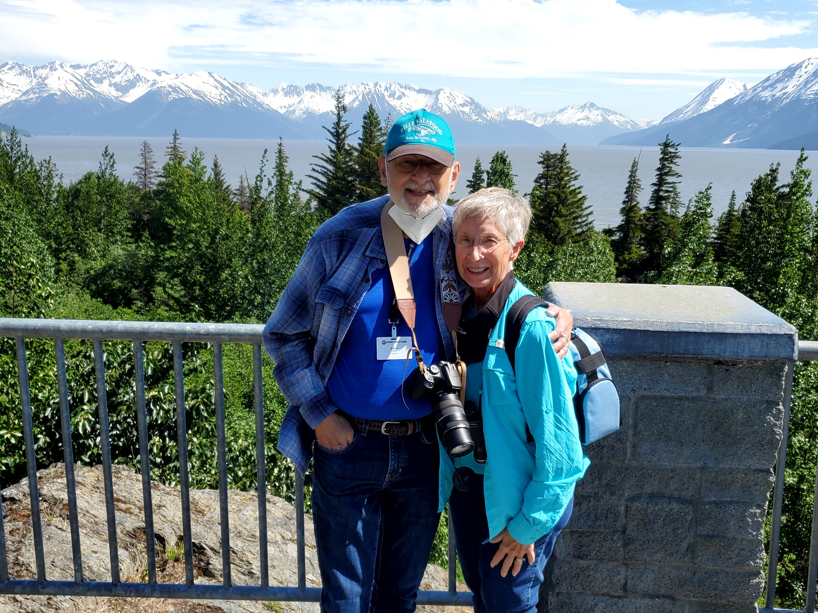
The Mesch Method – For Better or Worse
Prepare rough draft.
Review draft for consistency.
Make sure data is correct and is referenced.
Review draft with Grammarly or other editing software.
Check the story timeline.
Let “She who must be obeyed” check the draft.
Accept her edits and suggestions.
Remember she still loves you and you love her.
While the Queen is reviewing your humble efforts, organize footnotes, bibliography, and index.
Review draft again discussing any issues that La Padrona has raised.

Slide 23
Alliance of Independent Authors
The Alliance of Independent Authors (AIA) is a non-profit professional association for authors who self-publish. Their mission is ethics and excellence in self-publishing.
The AIA provides “trusted, best-practice information and advice to the author community and provides our members with “an extensive suite of benefits.”
The AIA has members on all seven continents.
They offer self-publishing services center, guidebooks, live streams, podcasts, and blogs.
The AIA works in four areas:
  Provides advice through the Self-Publishing Advice Center
  Monitors the self-publishing sector through the watchdog desk
  Campaigns for the advancement of indie authors in the publishing and literary
Source: https://www.allianceindependentauthors.org/facts/
Source: The Alliance of Independent Authors

Slide 24
Statistics from AIA - Income Levels
The median income level for some of the genres in 2022. Sample size in parentheses.
  Biography $796 (8)
  Children’s $3,000 (89)
  Crime/Thriller/Detective $18,893 (270)
  Fantasy/Sci-Fi/Speculative $7,982 (330)
  General Fiction $1,057 (64)
  General Nonfiction. $13,538 (54)
  Historical Fiction $7,421 (129)
  Horror $2,324 (24)
  Memoir $2,474 (21)
  Narrative Nonfiction $10,000 (13)
  New Adult $145,448 (2) *
  Romance $38,800 (496)
  Women’s Fiction $9,226 (45)
  Young Adult $1,686 (35)
  Other $10,000 (151)
In 2022, the median income of the AIA indie authors was $12,755.
The income was $10,000 for ages 55-64 and $3,000 for those 65 years and older.
* New adult books are a genre for 18-25-year-olds that feature two lovers with troubled pasts who defy extraordinary odds to be together.
Source: https://www.allianceindependentauthors.org/facts/
The Alliance of Independent Authors

Slide 25
Statistics from AIA - Income Comparison Between Self Published Authors and Traditionally Published Authors
Self-published authors earn more than authors who are traditionally published.
Self-published female authors earn more than self-published male authors.
LGBTQIA+ self-published authors earn more than heterosexual self-published authors.
Successful self-published authors are not “agreeable”… and that's good!
75% of book sales were part of a series (fiction and non-fiction).
Source: https://www.allianceindependentauthors.org/facts/
Source: The Alliance of Independent Authors

Slide 26
Types of Book Editing Services
Developmental editing – looks at the book’s big picture and overall structure in nonfiction or plot and characters in fiction.
Line editing – goes through each line refining the arrangement of words and phrases to create well-formed sentences and smooth-transitioning paragraphs.
Copyediting – corrects grammar, punctuation, and spelling errors. Copyediting also includes correcting commonly confused words (e.g., affect and effect) as well as checking for internal consistency of facts and consistency with capitalization, hyphenation, and numerals.
Proofreading – a final check before publication to find missed typos, missing words, repeated words, spacing and formatting consistency.

Slide 27
Is It Worth It?
Number of Words | $.01 per word | $.02 per word | $.03 per word | $.04 per word
70,000 | $700 | $1,400 | $2,100 | $2,800
80,000 | $800 | $1,600 | $2,400 | $3,200
90,000 | $900 | $1,800 | $2,700 | $3,600
100,000 | $1,000 | $2,000 | $3,000 | $4,000
Are the benefits of the service worth the cost?

Slide 28
Traditional Publishers Royalties
Royalty per Book
Number of Books to Pay for Editing
Book Price | 5% | 10% | $1,600 | $2,400
$10 | $.50 | $1.00 | 1,600 books | 2,400 books
$15 | $.75 | $1.50 | 1,067 books | 1,600 books
$20 | $1.00 | $2,00 | 800 books | 1,200 books
$25 | $1.25 | $2.50 | 640 books | 960 books

Slide 29
Self-Publishing Royalties
Royalty per Book
Number of Books to Pay for Editing
Royalty/ Editing Cost | 35% | 70% | $1,600 | $2,400
$10 | $3.50 | $7.00 | 229 books | 343 books
$15 | $5.25 | $10.50 | 153 books | 229 books
$20 | $7.00 | $14,00 | 114 books | 171 books
$25 | $8.75 | $17.50 | 92 books | 138 books

Slide 30
Benefits of Joining a Writing Group – Part 1
Get valuable feedback.
  Safe place to share your own writing and get authentic feedback.
  Critiquing someone else’s writing can even show you ways to improve your own work.
Be accountable to your group.
  Share your writing goals with your group.
  Avoid procrastination when other people are counting on you.
Receive encouragement from other members.
  Members will be supportive of your endeavor, offering words of encouragement and advice to help keep you going.

Slide 31
Benefits of Joining a Writing Group – Part 2
Find beta readers.
  Choose writing friends from your group to be your beta readers.
  These are people who do a read-through of your story and give feedback.
Get help with your story.
  When writer’s block hits you, run your problem past your writing group.
  Navigate through slow writing times by bouncing ideas off group.
Refine your writing process.
  Help you become a better writer.
  Obtain advice on the writing process.
  Exchange ideas on the finer points of the craft.

Slide 32
Six Tips for Finding a Writing Group – Part 1
Find a local writing group near you.
  Visit a nearby community center.
  Check the listings at your local library.
  Find a writer's workshop that fits your schedule.
Go on a writing retreat.
  A writer’s retreat will cost money and is usually a destination event.
  Dedicate all of their time to writing and to connect with other writers.
Join different writers’ associations.
  There are a variety of writer’s associations with local chapters.
  Connect with an association like National Novel Writing Month—NaNoWriMo—
  Find a writing group by genre,
  You can also find indie writing groups by location.

Slide 33
Six Tips for Finding a Writing Group – Part 2
Look Online.
  Search for a meetup group near you with other area writers.
  Narrow your search by genre
Find online writing groups.
  Explore Facebook groups to connect with people over chat or video.
  Check out online critique groups on websites like Scribophile or Critique Circle.
Start your own writer’s group.
  Recruit other local writers by posting a note at a coffee shop or library, asking members of your book club to join, or posting on social media.
  One advantage of starting your own group is you can make it what you want.

Slide 34
Writing Groups Near Me
Plano Writer’s Group
Step-by-step instructions to become a best seller.
  Determine your readership,
  Design your Style and introduce elements of the genre,
  Create the book with a step-by-step proven system,
  Editing your work,
  Creating an Effective Pre-Launch,
  Introducing Book Launch and Signings,
  Networking With Authors & Readers,
  Sweat Equity Marketing Campaigns,
  Business Development and Publicity.
Writing Group at Sam Johnson Recreation Center
  Meets every two weeks for two-hours
  Participants read selection from their writing
  Not all attendees want to publish their work

Slide 35
Suggested Homework
Attend a Writing Group Meeting and Ask Yourself these Questions
  How many people are in the group?
  How many are interested in improving their writing?
  How many are interested in publishing their writing?
  What constructive criticisms did they offer on your writing?
  Did you like the people?
  Will spending time with this group be beneficial or a waste of time?

Slide 36
Class Two – From Writer to Author
Session 3 – Other Elements of the Book – Part 1
Allen H. Mesch
For
Plano Parks and Recreation

Slide 37
Review
Previous Class
    Mesch Editing Method
    Alliance of Independent Authors
    Book Editing Services
    Benefits of Writing Groups
    Finding a Writing Group
Discuss Homework
Review of Writing Group
  How many people are in the group?
  How many are interested in improving their writing?
  How many are interested in publishing their writing?
  What constructive criticisms did they offer on your writing?
  Did you like the people?
  Will spending time with this group be beneficial or a waste of time?

Slide 38
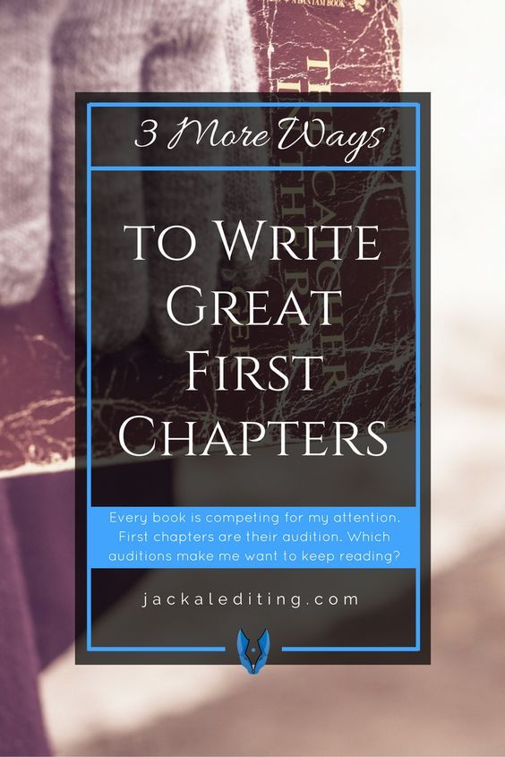
Oh, that Important First Chapter
What is the hook that will make readers venture into Chapter 2?
  Engage readers
  Who is the hero?
  Do we like him or her?
  Do we care about what happens to him or her?
  What is he or she trying to accomplish in the story?
  Is this goal worthy?
  Is the goal significantly important that we want to find out if your hero achieves it?
  What challenges does your hero have to overcome and are they substantial enough to understand how difficult they are?
  Establish the tone of the story

Slide 39
Other Editing Issues – Part 1
Should italics or quotation marks be used for a character’s internal thoughts?
  If you’re writing fiction, you may style a character’s thoughts in italics or quotation marks.
  Using italics has the advantage of distinguishing thoughts from speech.
Parallel sentence
  Words are formed in the same way or have the same structure.
  Example
  I like to run, eating, and jump. (Not parallel).
  The list in this sentence is run, eating, and jump.
  This sentence is not parallel because the grammatical formation are not the same.
  We need to make the structure of the words agree with each other.
  I like to run, to eat, and to jump. (Parallel).

Slide 40
Other Editing Issues – Part 2
What is a Dangling Preposition?
A dangling preposition refers to a preposition whose object occurs earlier in the sentence or does not have an object in the sentence at all.
It is left “dangling,” “hanging,” or “stranded” because it does not form a complete prepositional phrase. For example:
  “Don’t worry, sweetie, there is nothing to be scared of!”
  “ Each student will be asked to give a brief presentation tomorrow, so make sure you have something to talk about.”
  “I just bought some new music to listen to.”
  “He wished he had a friend to travel with.”
Move the preposition to an earlier part of the sentence before its object.
Add a pronoun if the dangling preposition doesn’t have an object.
Not a hard and fast rule!

Slide 41
Other Editing Issues – Part 3
Dialect is the language used by people of a specific region, class, or other social group.
Dialect distorts and often results in odd spellings and word gimmicks marking it hard for readers to decode
How to write accents and dialects
  Make sure you use accent and dialects for the right reasons – avoid stereotypes – integral to the story
  Make a list of regional colloquialisms/slang
  Use eye dialect carefully – alternate spellings of words – use “fallin’.”
  Learn how to write accents other ways – using word choice and placement
  Learn to use the most common language errors
  Create local speech variations with idioms and sayings
How to Write Accents and Dialects: 6 Tips, nownovel.com

Slide 42
Other Editing Issues – Descriptions - Part 1
1. You don’t always have to be specific.
In The Great Gatsby, the reader never really learns the color of Daisy’s hair or eyes. “Her face was sad and lovely with bright things in it, bright eyes and a bright passionate mouth.”
2. Use figurative language.
“I … easily spotted her blond hair like a white flame… The edge of her white kimono flapped open in the wind and I could see her breast, low and full. Her beauty was like the edge of a very sharp knife”
3. Describe facial expressions.
“Besides the neutral expression that she wore when she was alone, Mrs. Freeman had two others, forward and reverse, that she used for all her human dealings. Her forward expression was steady and driving like the advance of a heavy truck.”
4. Make the descriptions match the tone.
“He was a funny-looking child who became a funny-looking youth—tall and weak, and shaped like a bottle of Coca-Cola.”
5. Scatter physical descriptions throughout the prose.

Slide 43
Other Editing Issues – Descriptions - Part 2
6. Describe actions that reveal physical characteristics.
“As we’d been talking, she’d pulled [her hair] into a high, loose bun with shorter pieces of hair falling around her face.”
7. A first person narrator can give biased opinions about appearances.
“I was, and still am, despite mes malheurs, an exceptionally handsome male; slow-moving, tall, with soft dark hair and a gloomy but all the more seductive cast of demeanor.”
8. Describe clothing and accessories.
“Today Charis is wearing a sagging mauve cotton jersey dress, with a fuzzy grey cardigan over top and an orange-and-aqua scarf with a design of meadow flowers draped around her neck. Her long straight hair is grey-blonde and parted in the middle; she has her reading glasses stuck up on top of her head.”
9. Describe the way characters move or carry themselves.
“She was a slender, small-breasted girl, with an erect carriage, which she accentuated by throwing her body backward at the shoulders like a young cadet.”
10. Remember that a little description can go a long way.
“She was a fat girl. She was fat all over and she huffed when she breathed.”

Slide 44
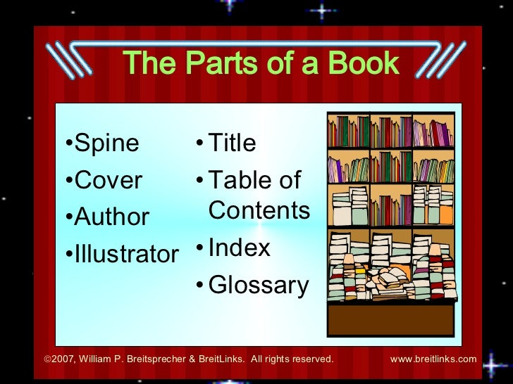
Other Elements of Your Book
Title
Preface
Table of Contents
Cast of Characters
Glossary
Acknowledgements
Author Biography
Cover Design
Back Cover Information

Slide 45
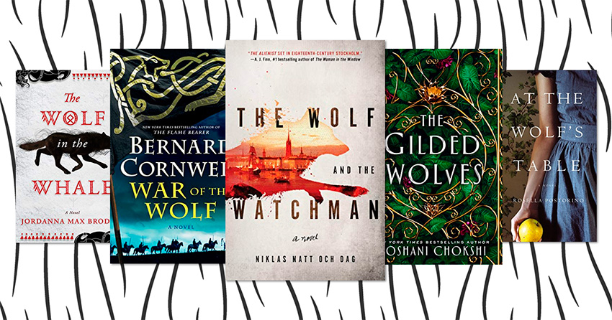
Title
Here’s how to develop book title ideas:
Use a book title generator tool
Write down the problem you’re solving
Create a subtitle to clarify
Make it memorable
Make sure it’s genre-appropriate
Create it to stir intrigue
Include your character in the title
Get feedback from your target audience

Slide 46
15 Best Book Titles of All Time
I Know Why The Caged Bird Sings by Maya Angelou
East of Eden by John Steinbeck
The Sun Also Rises by Ernest Hemingway
Do Androids Dream of Electric Sheep? by Philip K. Dick
The Curious Incident of the Dog in the Night-Time by Mark Haddon
Cloudy with a Chance of Meatballs by Judi Barrett
Pride and Prejudice and Zombies by Seth Grahame-Smith
The House of Mirth by Edith Wharton
Are You There, Vodka? It's Me, Chelsea by Chelsea Handler
And Then There Were None by Agatha Christie
Their Eyes Were Watching God by Zora Neale Hurston
The Devil Wears Prada by Lauren Weisberger
Brave New World by Aldous Huxley
Bury My Heart at Wounded Knee by Dee Brown
The Man Who Was Thursday by G.K. Chesterton

Slide 47
Book Title Generators
Nonfiction
  Nonfiction – Title Generator – Check out this awesome Nonfiction Book Title Generator Tool from SelfPublishing.com!
  Nonfiction – Portent’s Content Idea Generator
  Nonfiction – CopyWritingCourse Book Title Generator
  Nonfiction – Book Title Generator
Fiction
  Fantasy – Fantasy Novel Title Generator
  Fiction – Create Your Own Story Title Generator
  Science Fiction – Pulp Sci-Fi Title-O-Tron
  Sci-fi and Fantasy – UKRifter’s Book Title Generator
  Fiction – Story Toolz Half Title Generator
See: https://self-publishingschool.com/book-title-ideas-choose-perfect-title-book/

Slide 48
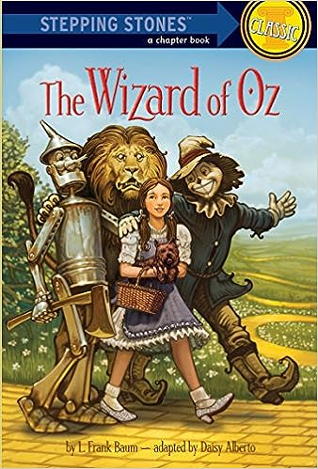
Ideas for Fiction Titles – Part 1
Start Free Writing to Find Keywords
Write absolutely anything that comes into your head:
words, phrases, names, places, and adjectives.
Try Playing Around with Formats like:
“The _____ of _______” or “______ and the _____”
If your central character has a quirky name or a title (like Doctor or Detective) (e.g. Thomas Hardy’s Jude the Obscure,
Keep your setting in mind
Is your book set somewhere particularly interesting or significant? (e,g, The Wizard of Oz or Picnic at Hanging Rock )

Slide 49
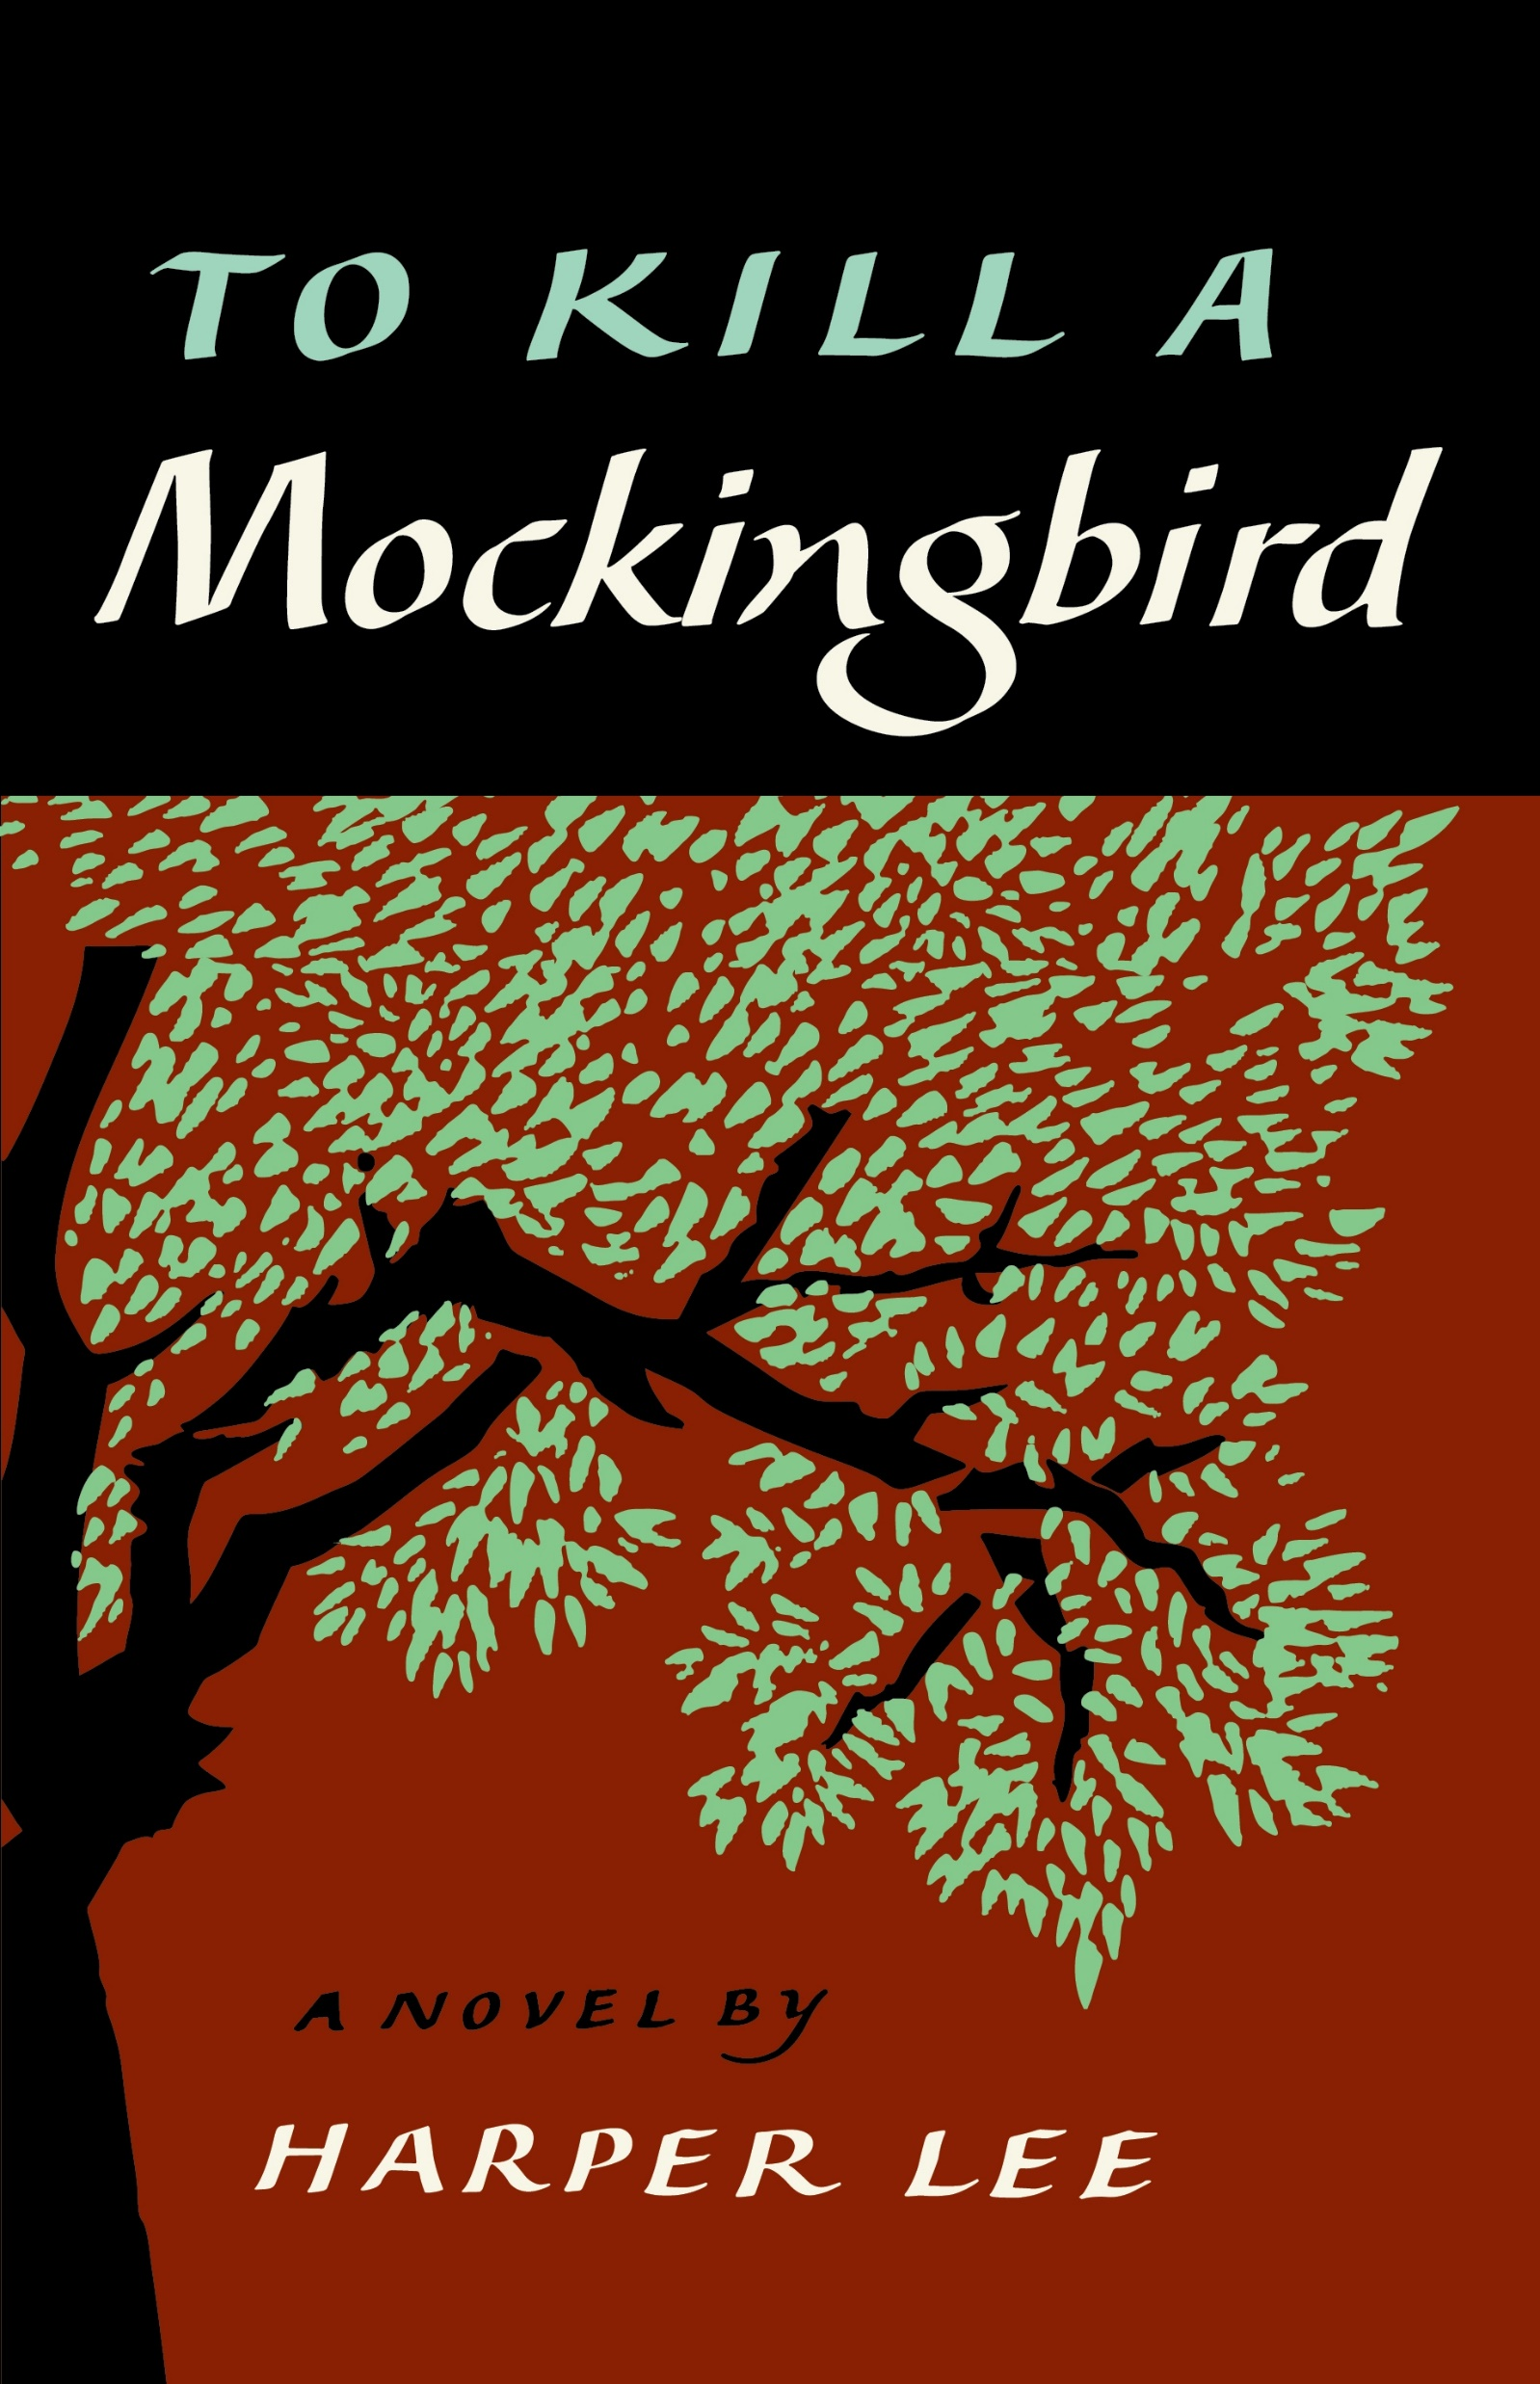
Ideas for Fiction Titles – Part 2
Look for book title ideas in famous Phrases
Think Harper Lee’s To Kill A Mockingbird here.
Think of your inspiration for writing your book or central theme
Analyze the book titles of other books
Many books refer to other works in their titles
(e.g. The Fault in Our Stars, Of Mice and Men, For Whom the Bell Tolls, and His Dark Materials)
Don’t Forget the Subtitle
In non-fiction publishing, there’s a trend of evocative or abstract titles, followed by a subtitle that communicates the content .
Generate a book name through a book title generator

Slide 50
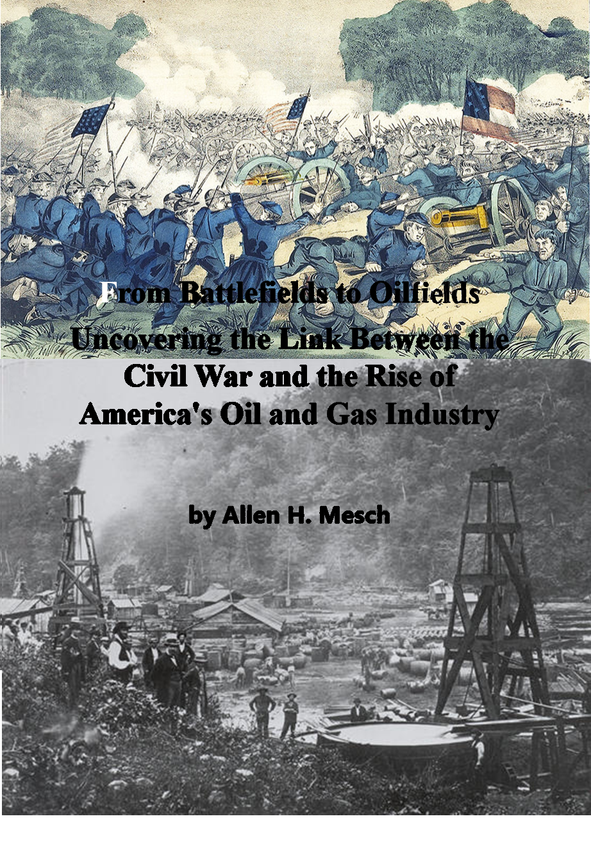
Titles Suggested for My Nonfiction Book
Beneath the Smoke: Unveiling the Duality of War and Oil in America's Industrial Revolution
From Battlefields to Oilfields: Unveiling the Link Between the Civil War and the Rise of America's Oil and Gas Industry
From Battlefields to Oilfields: Unveiling the Hidden Ties - How the Civil War Shaped America's Oil and Gas Industry with the Help of its Veterans
https://selfpublishing.com/book-title-generator

Slide 51
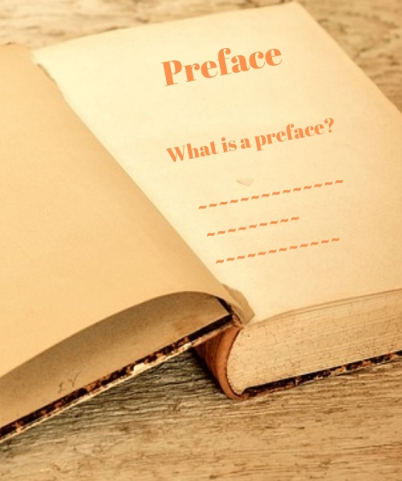
Preface
A preface is an introductory section of a book that comes before the main text.
Written by the author, a preface is meant to
draw readers in by offering information about the author’s experience writing the book
the inspiration behind the subject matter
the writing process
the purpose of the story, and historical context for the material.

Slide 52
Preface, Prologue, or Foreword
Preface: Most often found in nonfiction books or academic writing
  A preface is written from the point of view of the author.
  This reveals information about why the author wrote the book.
  A writer might talk about themselves and why they are qualified to write about this topic.
Prologue: Typically found in works of fiction
  A prologue is usually written from a character’s point of view.
  This gives the reader additional information that will help them understand the story.
  This can include background information on characters, events that took place before the story begins, or information that establishes the setting of the story.
Foreword: A foreword is an introductory section of a book written by someone other than the author.
  The person is usually a prominent figure like an expert on the subject, another author, or a critic.
  A foreword lends credibility to the book and author by praising the work, the writer, or both.

Slide 53
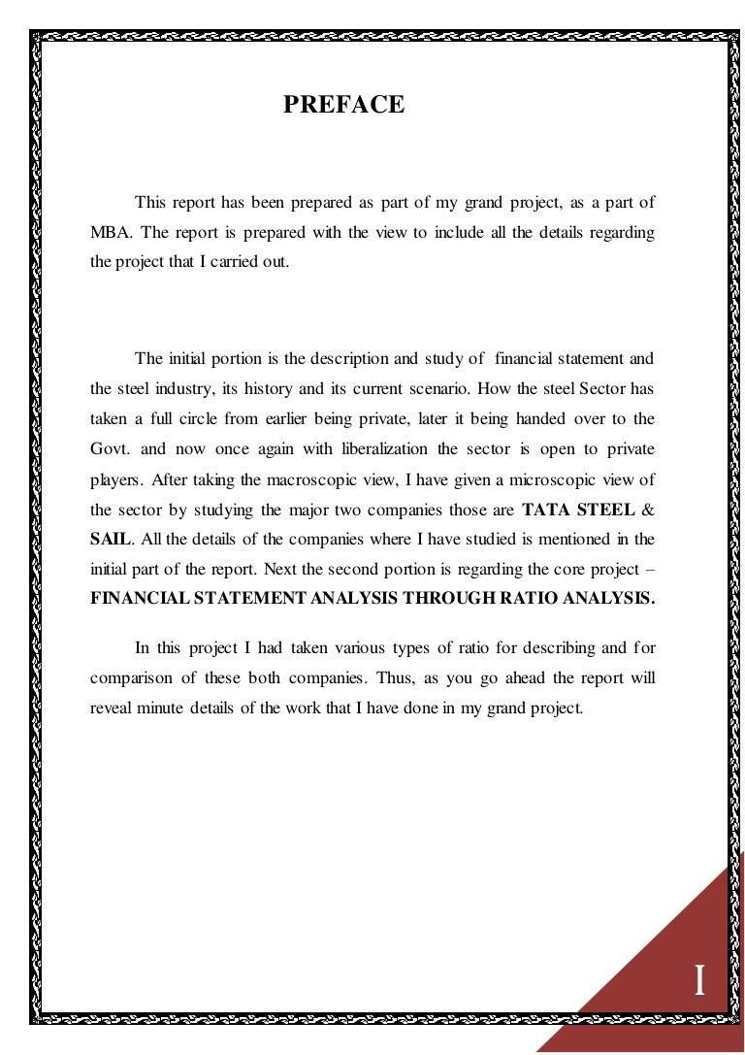
What Is the Purpose of a Preface in a Book?
Explain why the author chose to write about this topic
Reveal their motivation and inspiration for writing the book
Describe the process of researching the topic of the book
Outline the process of writing the book, including any challenges and how long it took
Introduce a new edition of the book and discusses what’s been changed
Provide information regarding relevant events that happened after an earlier edition of the book was published

Slide 54
How to Write a Preface
Brevity is Better
Be Interesting by offering interesting tidbits that stimulate the reader’s curiosity.
Think of a Preface as a “Making of”
  Information about how you assembled the book
  How you uncovered unique information in your research.
  Describe any challenges you overcame across while writing.
  Explain why you became interested in the subject of the book.
Inspire Readers by Sharing Your Passion.
  Tell the reader what triggered your interest in the subject and why you wanted to write about it.

Slide 55
Chapter Titles
1. Use Chapter Titles to Attract Your Audience
Lewis Carroll points to Alice’s travails with signposts like: “Down the Rabbit-Hole” and “The Pool of Tears.”
2. Use Chapter Titles to Find Your Focus
The best-built stories have chapters that work to support its overarching premise.
String titles together in a way that ties cause and effect to escalating tension .
3. Use Chapter Titles to Orient to Your Story World
Chapter titles can also orient you when you’re lost in the story swamp.
4. Keep Your Chapter Titles Flexible
400 Good Chapter Names Ideas and Suggestions
https://worthstart.com/chapter-names/

Slide 56

Table of Contents
The Table of Contents acts as a map for the reader, making it easier for them to find information in the document based on title and page number.
A good Table of Contents should be organized, easy to read, and simple to use.
You can write a Table of Contents manually on your computer or have a word processing tool create it for you.
Make sure the Table of Contents is formatted properly so it is as accurate and accessible as possible.

Slide 57
Suggested Homework
Use a book title generator to obtain a title for your book.
Write a preface or prologue for your book.
Make a table of contents for your book with dynamic titles.

Slide 58
Class Two – From Writer to Author
Session 4 – Other Elements of the Book - Part 2 and Prepublication Marketing
Allen H. Mesch
For
Plano Parks and Recreation

Slide 59
Review
Previous Class
    Book Titles
    Preface
    Chapter Titles
    Table of Contents
Discuss Homework
  Use a book title generator to obtain a title for your book.
  Write a preface or prologue for your book.
  Make a table of contents for your book with dynamic titles.

Slide 60
Glossary – Part 1
What is a glossary?
Words in another language or unfamiliar terms.
A glossary enables reader to “stay in the book” while still discovering what you need to understand.
Words should be arranged in alphabetical order, each on a separate line, and followed by its definition.
A glossary usually precedes the notes and bibliography or reference list.
Does my book need a glossary?
Dependent on the genre of your book, target audience, and detail of your book.
Helps readers get the most out of your story

Slide 61
Glossary – Part 1
In Nonfiction books a glossary will be useful especially if your book is difficult to read
In Fiction books a glossary outlines terms and shows their definitions to create a more enjoyable read.
A glossary for fiction is like a family tree.
A family tree outlines family members and shows their relationship to each other with the intention of providing clarity.
Including a glossary can benefit readers’ reading comprehension, overall understanding, and enjoyment of the book.

Slide 62

Acknowledgements
Certain principles determine acknowledgements:
People who provided funding, investments, graphics, special information, specific illustrations, editors, people or groups who provided research materials, people who are mentioned in the book.
Your reasons for acknowledging someone should be correct.
If their contribution cannot be well defined, use generic phrases, such as “for their support,” “for their “guidance,” etc.
Obtain the concerned person’s approval before adding name.

Slide 63
How to Write a Book Acknowledgement
Step 1: Make a list of each person who in any way inspired you, contributed to your knowledge, influenced you, or helped you in the creation of your book.
You can simply list the name of each person or organization you are acknowledging or include a description of their contribution.
Step 2: Review and condense list. Acknowledgments are one paragraph to one page long.
Step 3: List everyone after one sentence of thanks. You can also write a special thank you specifically for any individual or organization.
Step 4: Have peers or associates review your page for their input.
Step 5: Proofread your acknowledgment.
Step 6: Send each person or organization on your list a thank you note and a copy of your book letting them know their name is under the acknowledgments.
They will spread the word about your book.

Slide 64
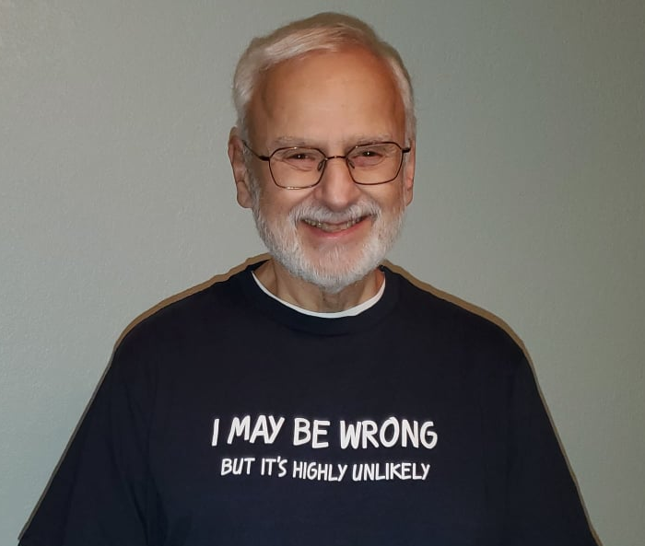
Author Biography – Part 2
1. Start with the facts readers need to know
  Begin with an opening byline that quickly summarizes your profile and your most recent release.
2. Add relevant biographical details
  Introduce yourself and introduce readers to your body of work
  Share a little about your writing history.
  Mention other titles that you’ve released
  May also want to include any personal connections to your work and why they’re relevant.
https://blog.reedsy.com/author-bio/

Slide 65
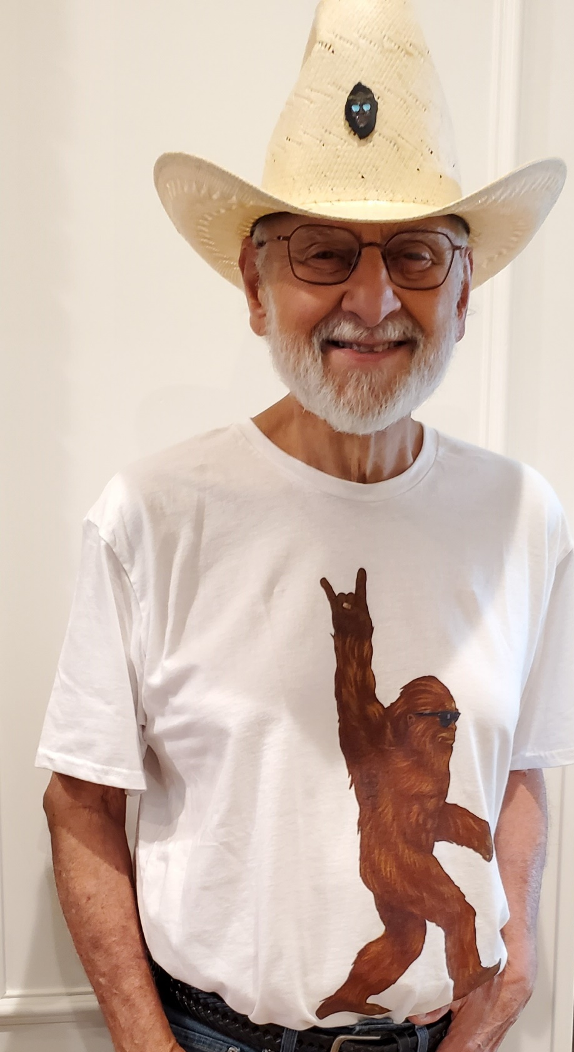
Author Biography – Part 2
3. Wow them with your credentials
  Show your qualifications and credibility so that a reader will feel validated in choosing your book to read
  Stick to credentials that directly relate to the content of book.
  Qualifications can include writing courses, college degrees, awards, bestseller lists, and accolades
4. Finish it off with a personal touch
  Add a bit of color to your bio to help readers imagine who you are.
  If they can relate to you, it might be an extra push for them to buy your book.
https://blog.reedsy.com/author-bio/

Slide 66
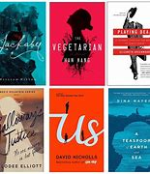
Book Cover Design – Part 1
If another person is designing the cover, they must understand the book’s content
Keep It the cover a simple design
Don’t create fancy cover designs
Don’t use a person’s photo on the cover
Make the cover scalable for Amazon and online buyers
Only give a hint of the story on the cover
Check if images are subject to copyright and are at least 300 DPI

Slide 67
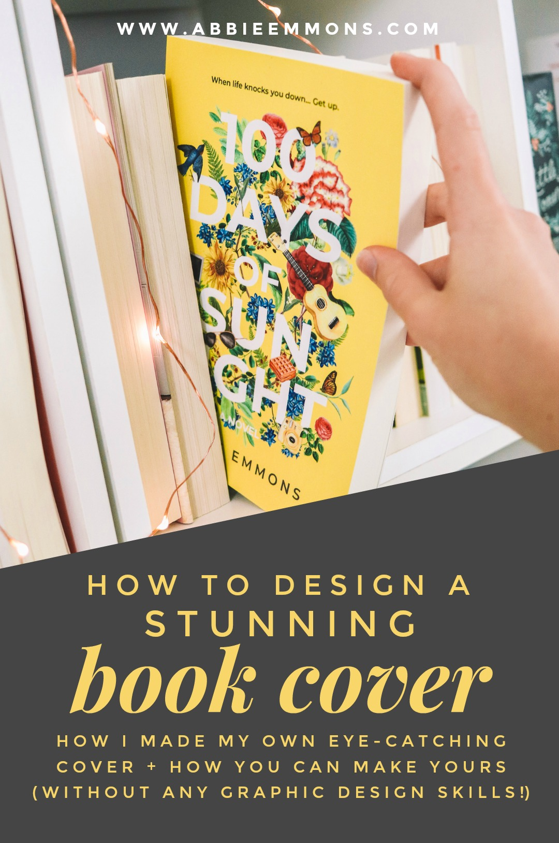
Book Cover Design – Part 2
Reveal the hook to engage the reader
Know the publishing techniques
Create an interesting and entertaining design
Use the color theme carefully
Pick right typography
Stick to your main message
Avoid cliches
Use social media to get opinions

Slide 68
Book Cover Creator Software
Canva Create Book Cover
Free for 30-days
Reedify Design
$179 for print book
$79 for e-book
Writer’s Clique
$599 or sale price of $349
Prolonged chat discussion
Book Cover Designs
From $149 to $549
Fotor Design Book Cover
Free trial
Visme Book Cover Design
Easy to use and then they hit you with the fee of $147 to $297 --- No

Slide 69
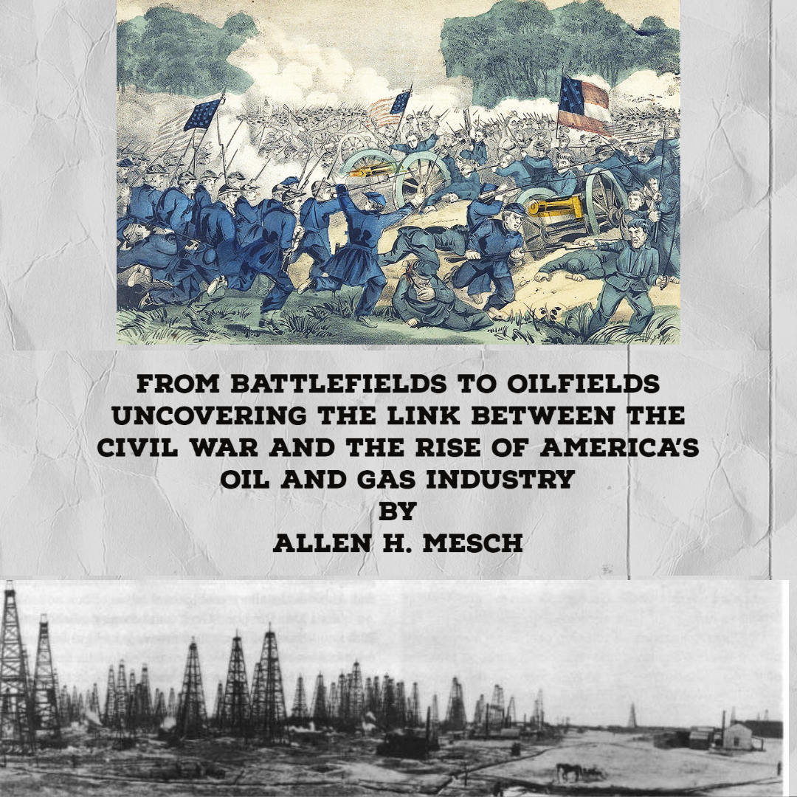
Adobe Express for Cover Design
Adobe Express
  Many different features
  Easy to use
  Free and Fee Templates
  Ability to add images
  Easy to add text

Slide 70
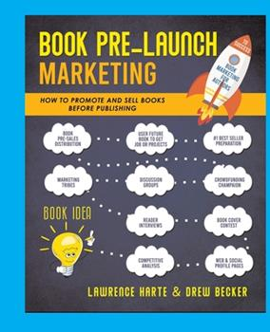
Pre-publication Marketing
Tell the “world” you’re writing a book!
Ideas to pursue:
  Facebook Author Page
  LinkedIn Page
  Webpage
  Writing Gigs
  Speaking Opportunities
  Plano Public Library – Propose/Present a Program – Engage Programs - Help From a Librarian / Suggest an Item

Slide 71
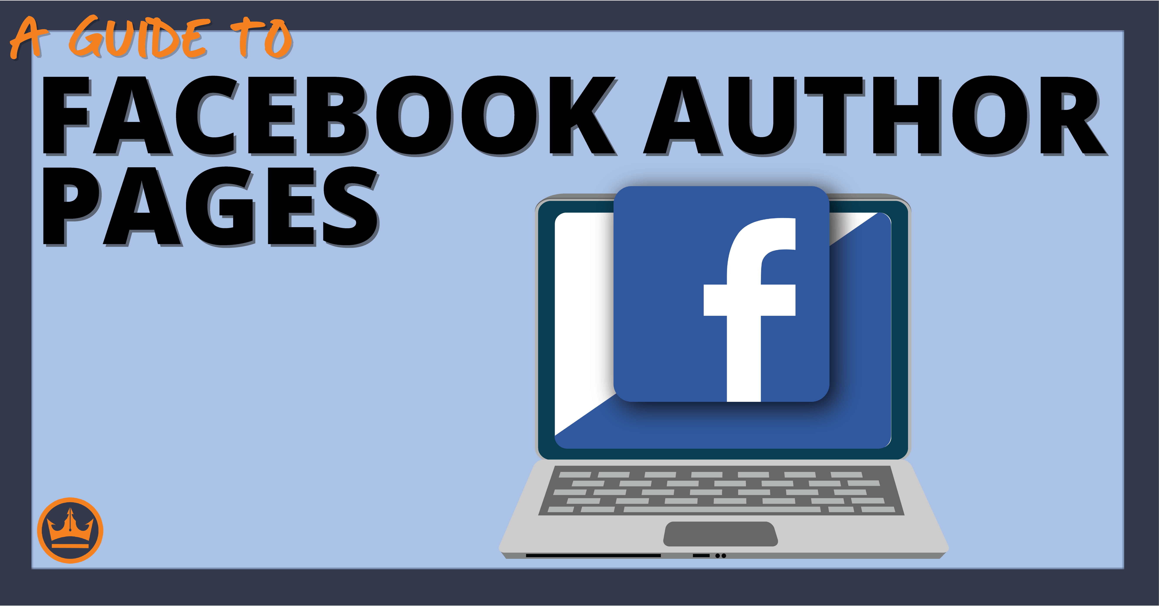
Facebook Author Page
If you have a Facebook profile, you can add an author page.
Tell readers about book
Encourage them to tell others about book.
Ask them to buy your book.
Ask for feedback.
Ask for people/places to host a signing event.
How to create a Facebook Author page,
www.writtenwordmedia.com/how-to-create-a-facebook-author-page/

Slide 72
LinkedIn Page
LinkedIn Writing Groups
Book Writing, Self Publishing & Marketing
Book Story: Writers Authors Poets Readers ~~ writing editing design publication marketing
TWO BITS / Writing Advice to Writers from Writers
Digital Marketing, Publishing, ebooks, Content Writing, Copywriting, SEO, SEM, SMM & pay per click
Writing to Grow
Creative Writing, Marketing Writing, Business Writing, Writing Consultancy & Self-Publishing
Aspiring Writers Blogs and Writing Tips
Creative Writing..
Create profile on LinkedIn
Post stories about your book
“I am looking for people to read my manuscript.”
“How do you like the title?”
“How to like the cover?”
Post stories on various writing groups

Slide 73
Develop Web Page
Wix - exceptional
GoDaddy - excellent
Web.com – very good - $149 for them to build site
Network Solutions - good
Squarespace – very good
HubSpot - good
Ionos – very good
A web page allows you to have a platform to highlight your book(s).
Most come with a blog that you can use to create interest in your book.
Locations
Events
Characters especially historic
Writing progress
Asking for people to review manuscript

Slide 74

Writing Gigs
Check out Submittable
  Short stories
  Poetry
  Fiction
  Nonfiction
  Art
  Contests
  First Chapters
  Scary Stories
17 pages of listings with compensation and deadlines (most are very short, like hours)

Slide 75
Speaking Opportunities – Part 1
How to Land Your First Gig as an Author
1. Start Local
Any group where your desired audience gathers can provide a chance for you to speak.
2. Speak to Your Niche
If your book is geared toward a specific niche, explore related groups.
3. Find a Natural Connection
Make sure the group you choose will be well-served by hearing your message.
4. Build Excitement
Establish a following of readers through your website, through online forums, via social media, and by writing blog posts, both your own and by writing guest posts for others.
5. Hone Your Skills
Practice makes perfect

Slide 76
Speaking Opportunities – Part 2
6. Produce Videos, Join Podcasts, and seek out online interviews
7. Attend a Writer’s Workshop
Meet other authors and pick their brains about their speaking process.
8. Speak at an Industry Event
These fact-based speaking engagements are perfect for non-fiction authors.
9. Aim Low (at First)
The first time, in fact, you may have to volunteer your time to speak at a tiny event.
10. Practice Makes Perfect
Write a speech today and read it to yourself daily. Practice and refine your speech.
11. Say YES!
Say yes to your first speaking engagement! Gain valuable experience, polish your skills, and get your book’s message out there to the public.
SpeakerHub (not sure about this organization, might be worth a look)

Slide 77
Suggested Homework
If you plan to attend, bring this homework to Session 1 of Class 3
  Write a brief description of the book that might appear on Amazon
  Complete at least the first three chapters of the book
  Who is your audience? – Who will want to read your book?
  How long is your book in words and pages
  Work on your book – creating and editing it for publication.
  Create an author page on Facebook
Thanks for attending Class 2.

